Slide 1
Instant Neural Graphics Primitives with a Multiresolution Hash Encoding
https://nvlabs.github.io/instant-ngp/

Slide 2
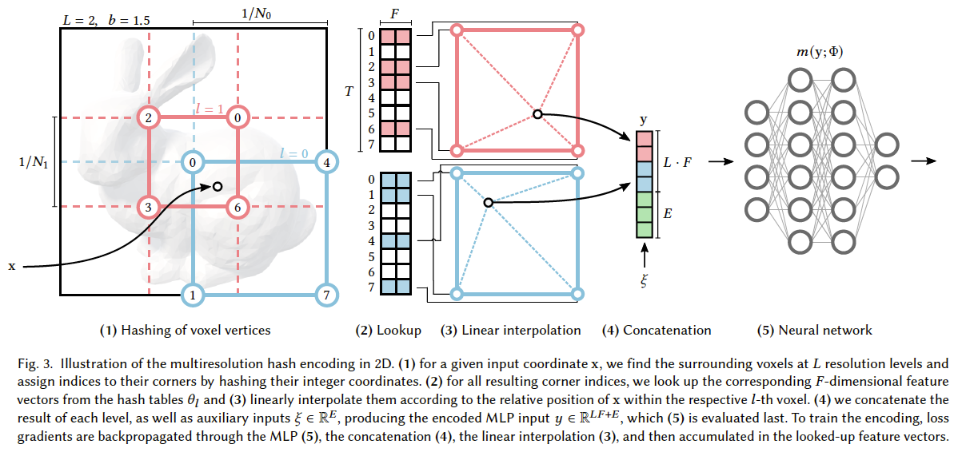
Illustration
Notes:
用大量存储来换取较小的计算消耗。
NeRF 成功，映射网络输入到高维空间。

Slide 3
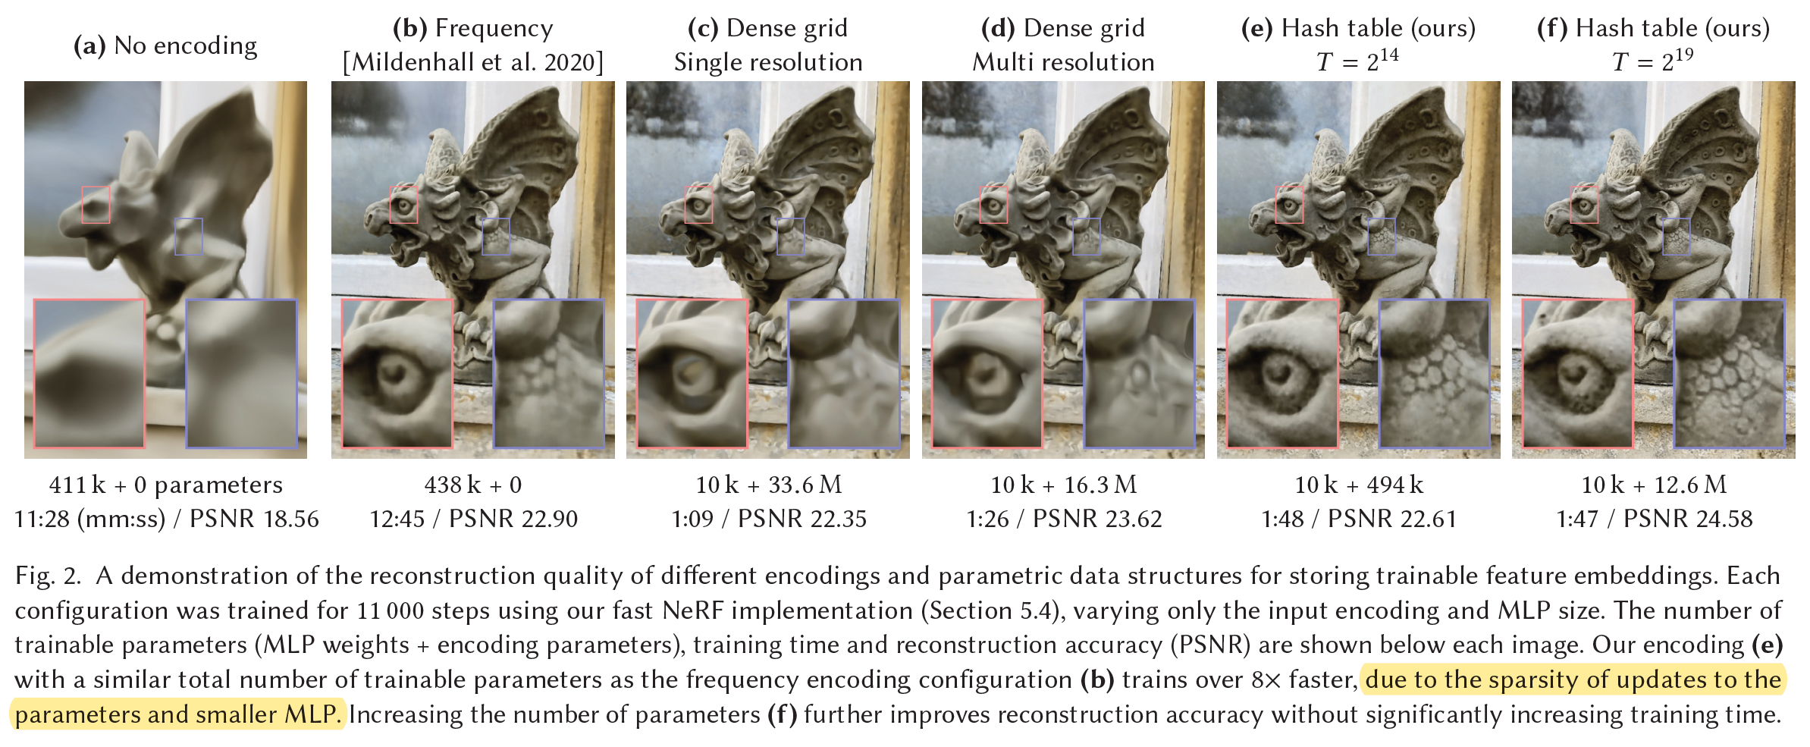
Different encodings and parametric data structures
Notes:
D: 16 to 173
It allocates as many features to areas of empty space as it does to those areas near the surface.
Good caching behavior due to predictable memory layout of the hash tables that is independent of the data that is represented.

Slide 4
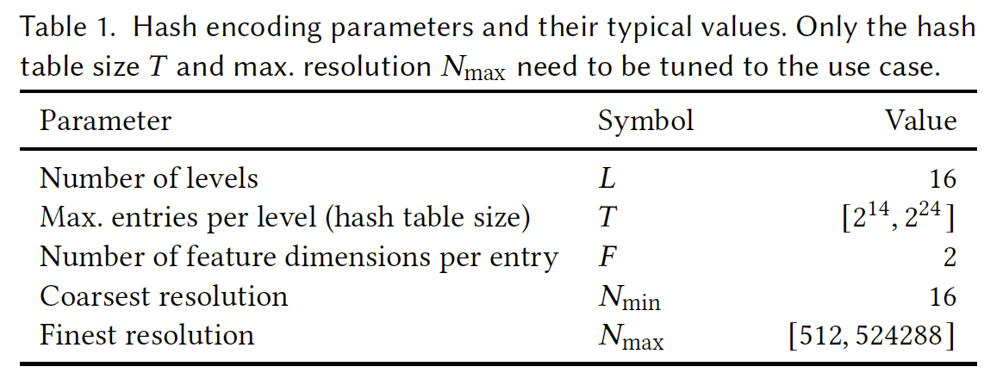


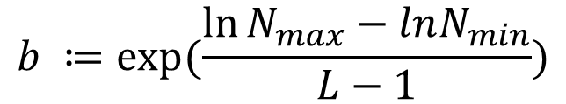
Multiresolution hash encoding
$$b ≔exp⁡(\frac{\ln{N_{max}}−lnN_{min}}{L−1})$$
$$N_{l} ≔ \left\lfloor N_{min}∙b^{l}\right\rfloor$$
$$x_{l} ≔x∙N_{l}$$

Slide 5
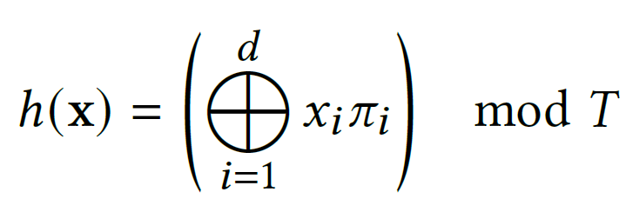


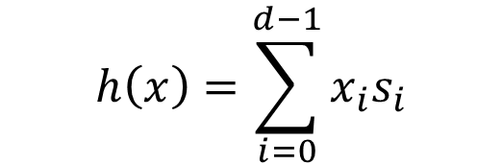



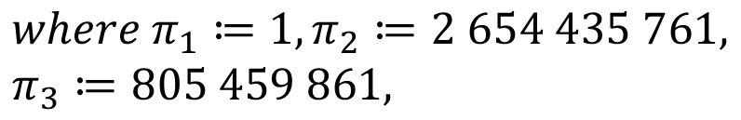
Multiresolution hash encoding
$$h\left(x\right)=\sum_{i=0}^{d−1}{x_{i}s_{i}}$$
$$\left\lfloor x_{l}\right\rfloor ≔\left\lfloor x∙N_{l}\right\rfloor$$
$$\left\lceil x_{l}\right\rceil ≔\left\lceil x∙N_{l}\right\rceil$$
$${where s}_{i} :=N_{l}^{i}$$
$$if T<N_{l}^{d}$$
$where π_{1}≔1,π_{2}≔2 654 435 761,$ $π_{3}≔805 459 861,$
$$w_{l} :=x_{l}−\left\lfloor x_{l}\right\rfloor$$
Notes:
虽然1严格来说不是一个素数，但它能帮助取得更好的存储一致性。

Slide 6
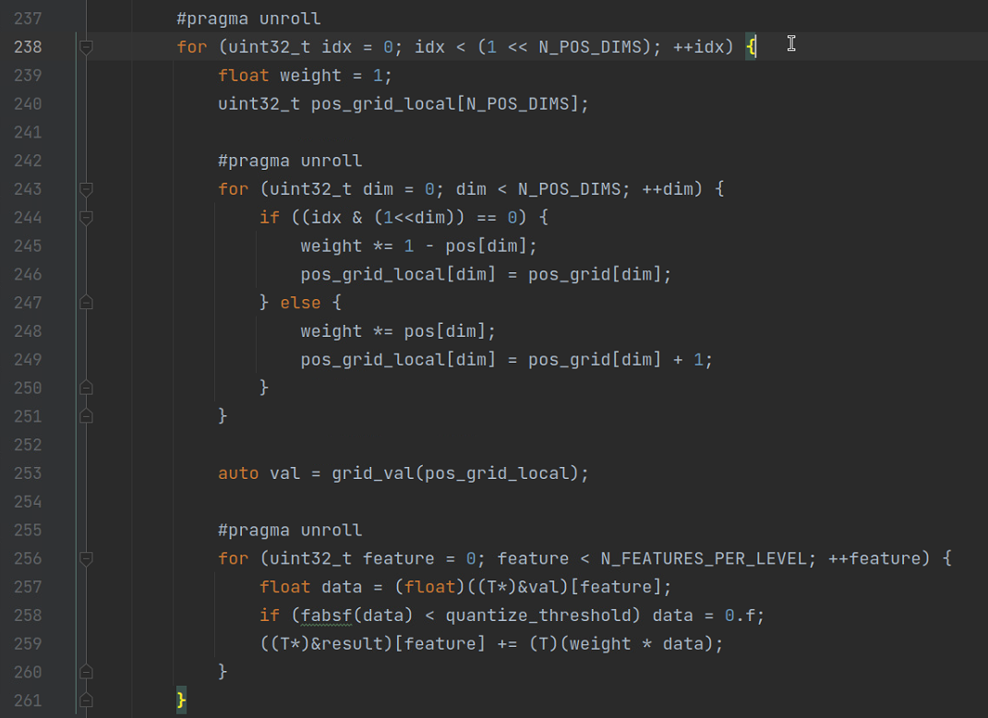
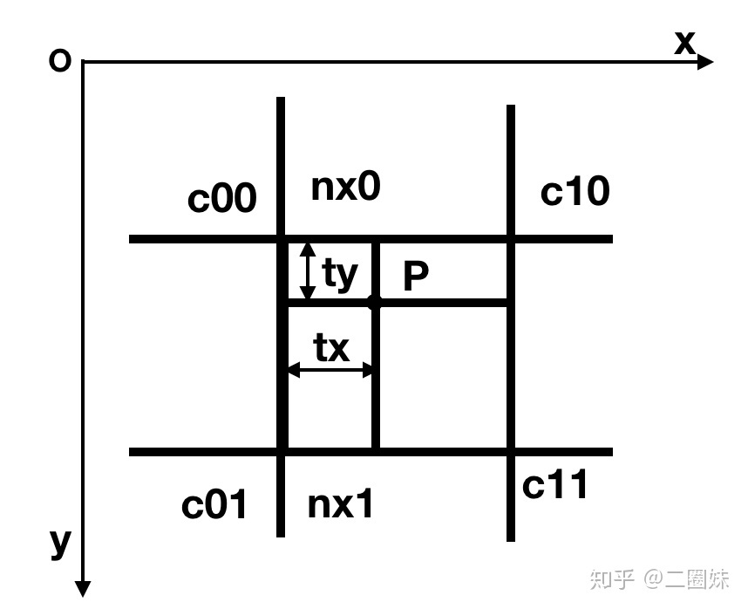
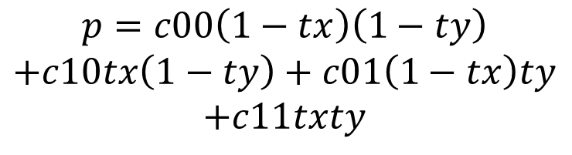
Interpolation
$$p=c00\left(1−tx\right)\left(1−ty\right)$$
$$+c10tx\left(1−ty\right)+c01\left(1−tx\right)ty$$
$$+c11txty$$

Slide 7
Key to hash encoding success
Use neural network to learn to disambiguate hash collisions itself.
Different resolution levels have different strengths that complement each other.
Good caching behavior due to predictable memory layout of the hash tables that is independent of the data that is represented.

Slide 8

Ray marching
Init input
Camera position
Camera direction
Bounding box [0,1]^3
Input for each ray
pos
dir
t
t
pos

Slide 9
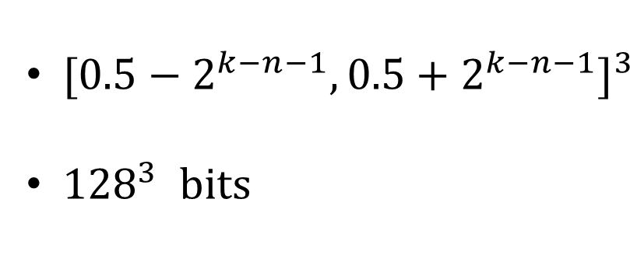
Density grid
K=n
1
K=n-1
${[0.5−2^{k−n−1},0.5+2^{k−n−1}]}^{3}$
${128}^{3} bits$
K=0
0
1

Slide 10
Hardware implementation
dt = t/256
dt = t<<8
calculate t, tx, ty, tz independently
dty
dt
ty
t
tx
dtx

Slide 11
Hardware implementation
dt = t/256
8 steps each cycle

Slide 12
Hardware implementation
dt = t/256
8 steps each clock
save ts, te
recalculate from each ts

Slide 13
Hardware implementation

